Slide 1


Slide 2


Slide 3
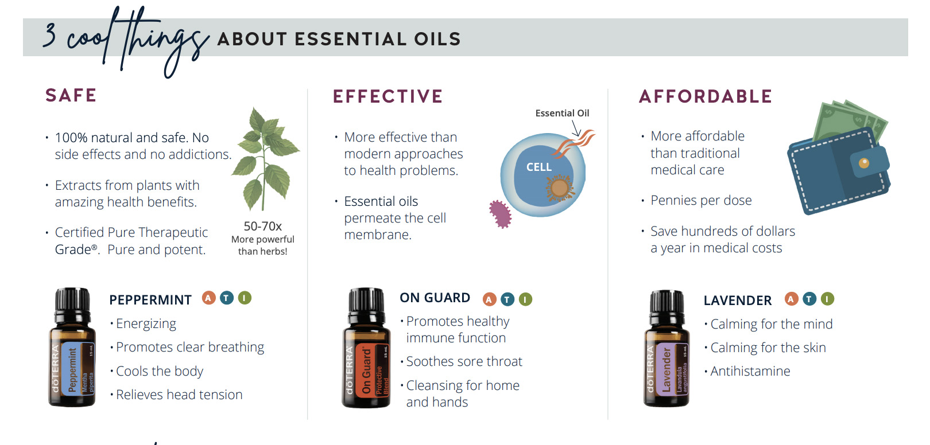

Slide 4


Slide 5
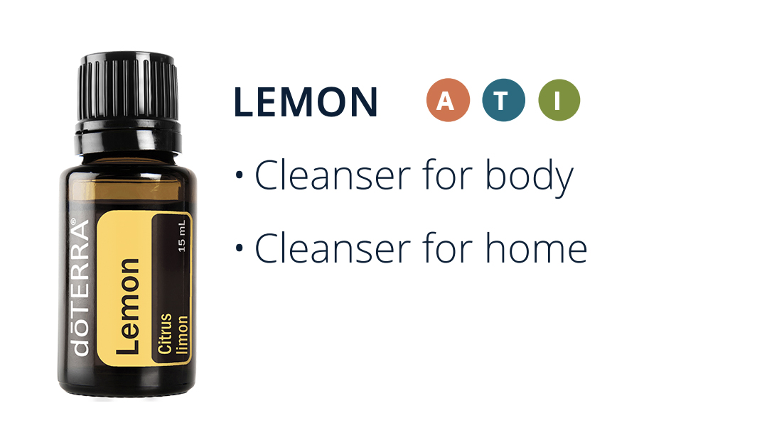

Slide 6
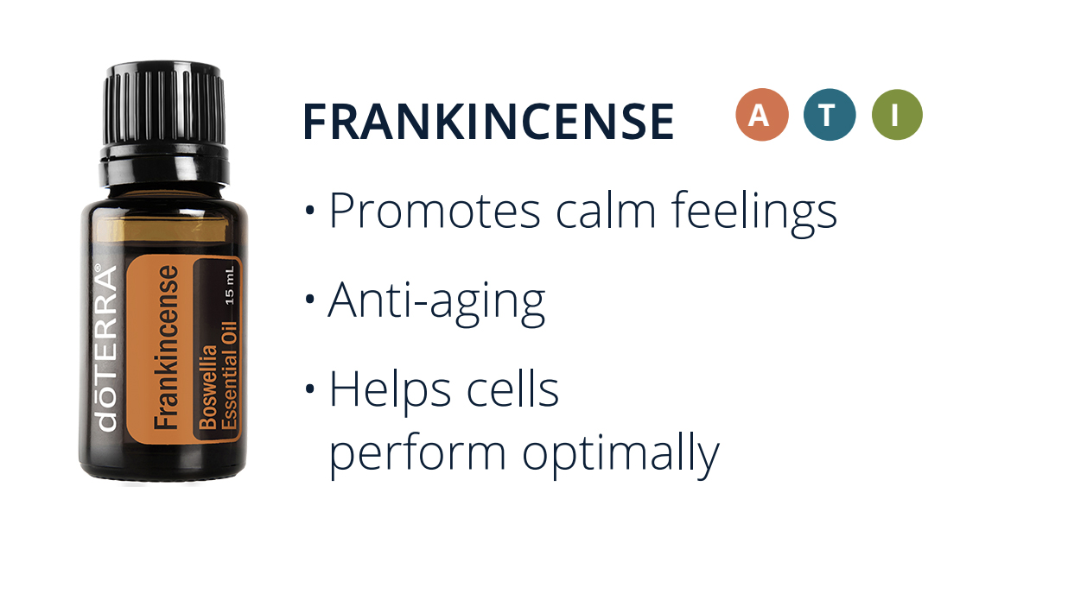

Slide 7


Slide 8
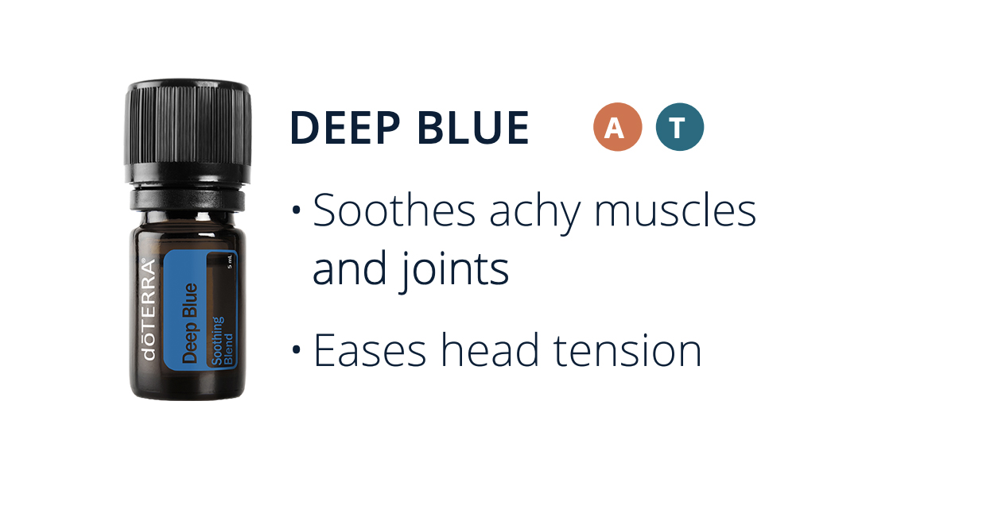

Slide 9
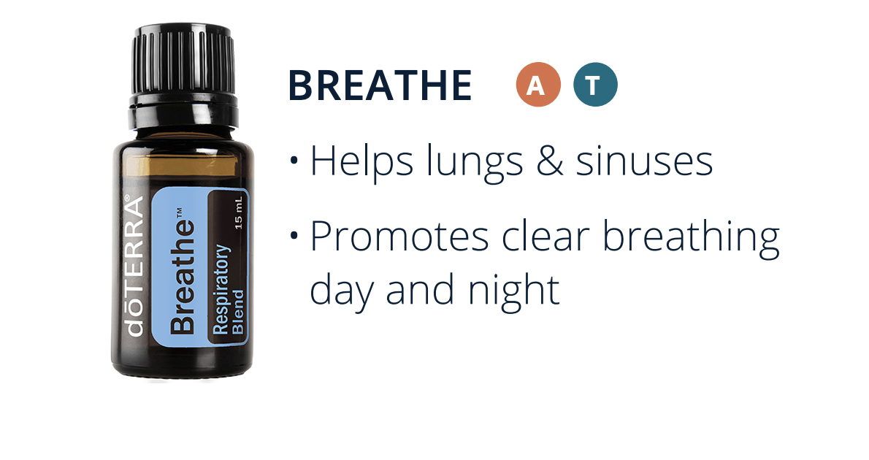

Slide 10
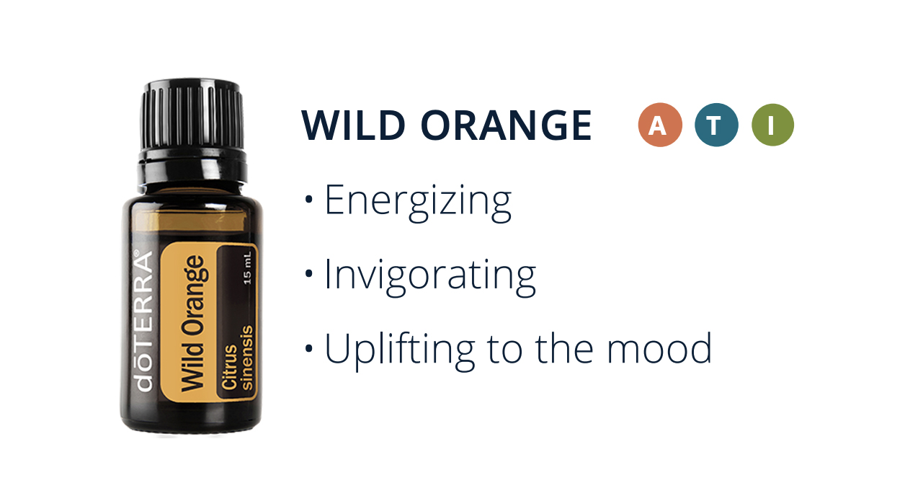

Slide 11
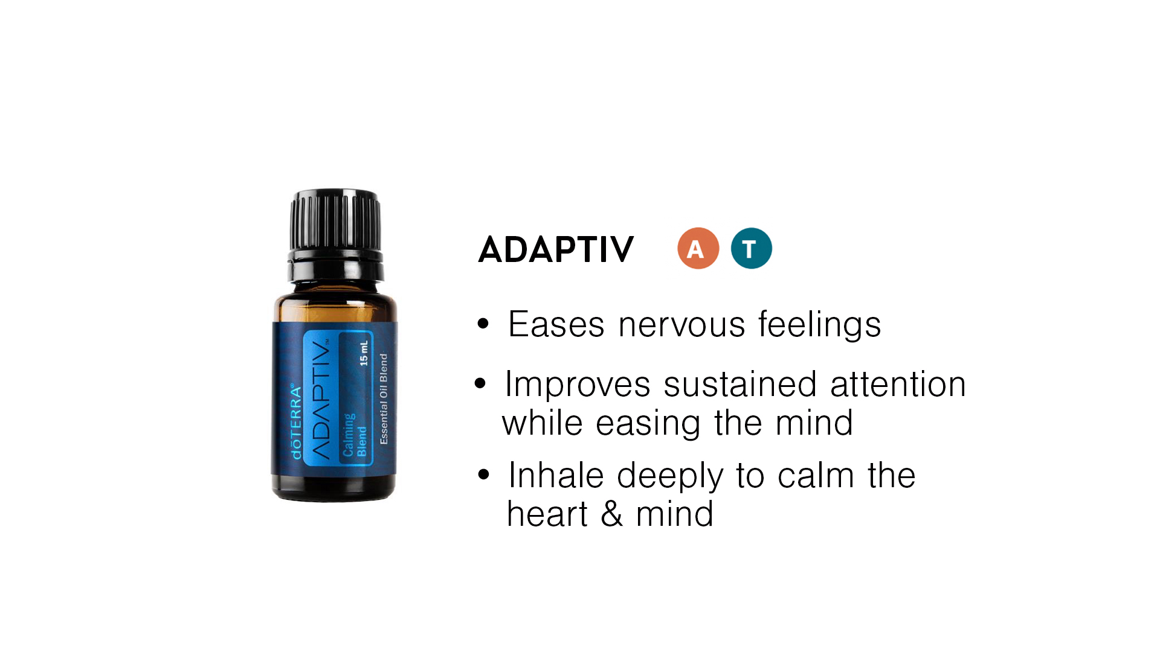

Slide 12
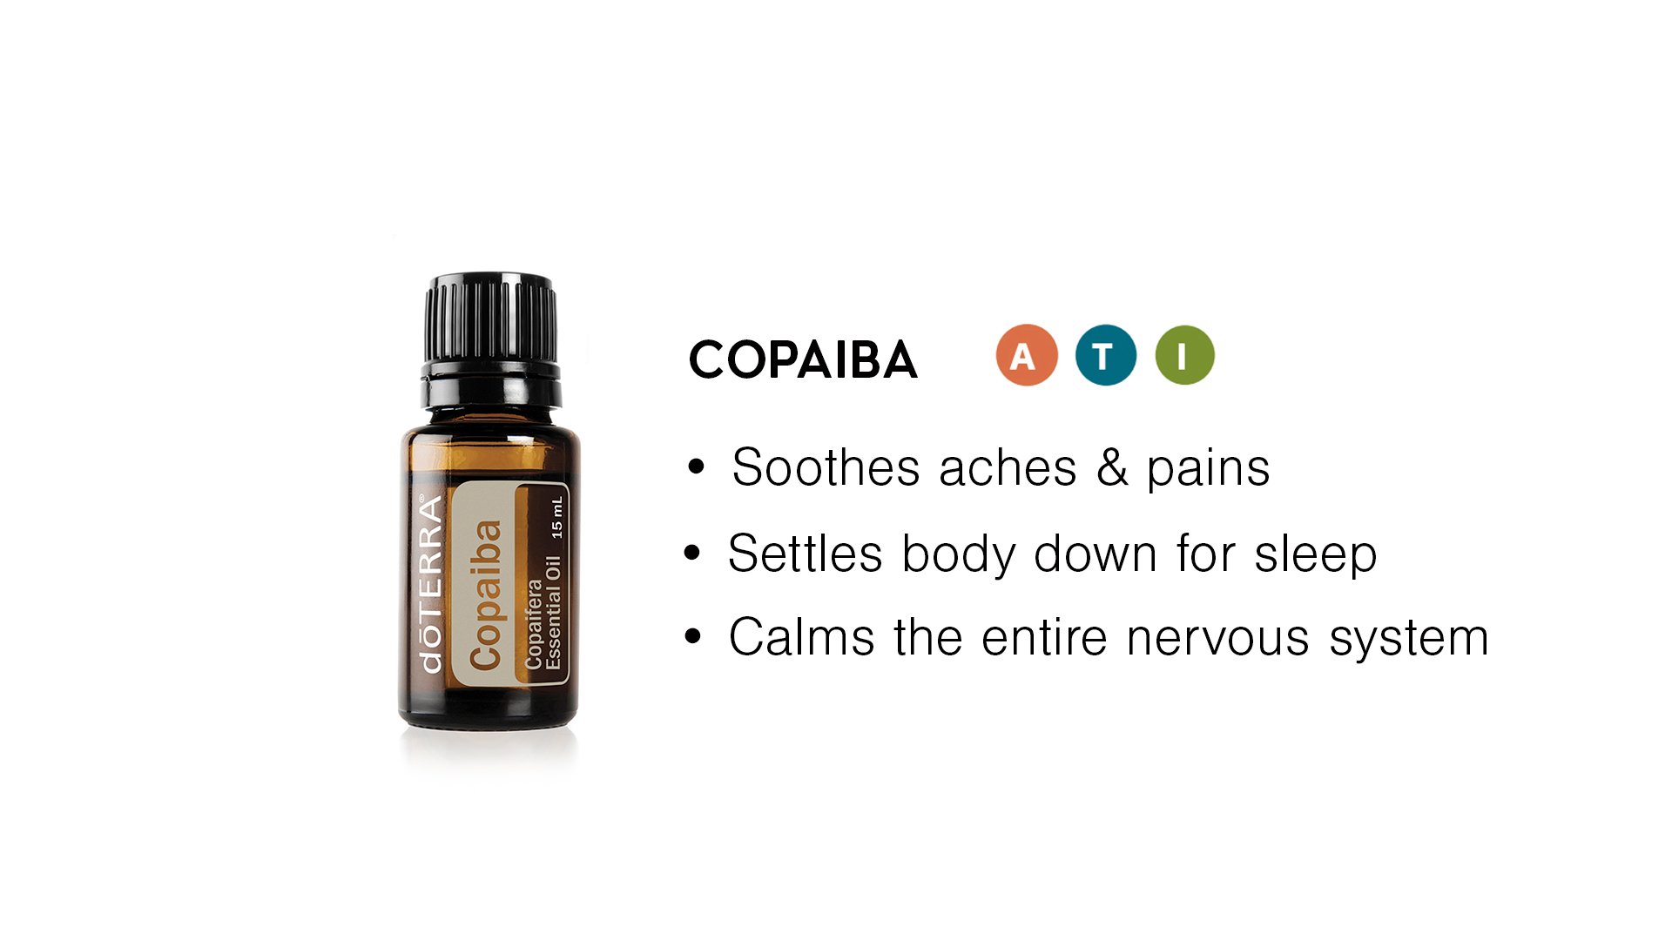

Slide 13
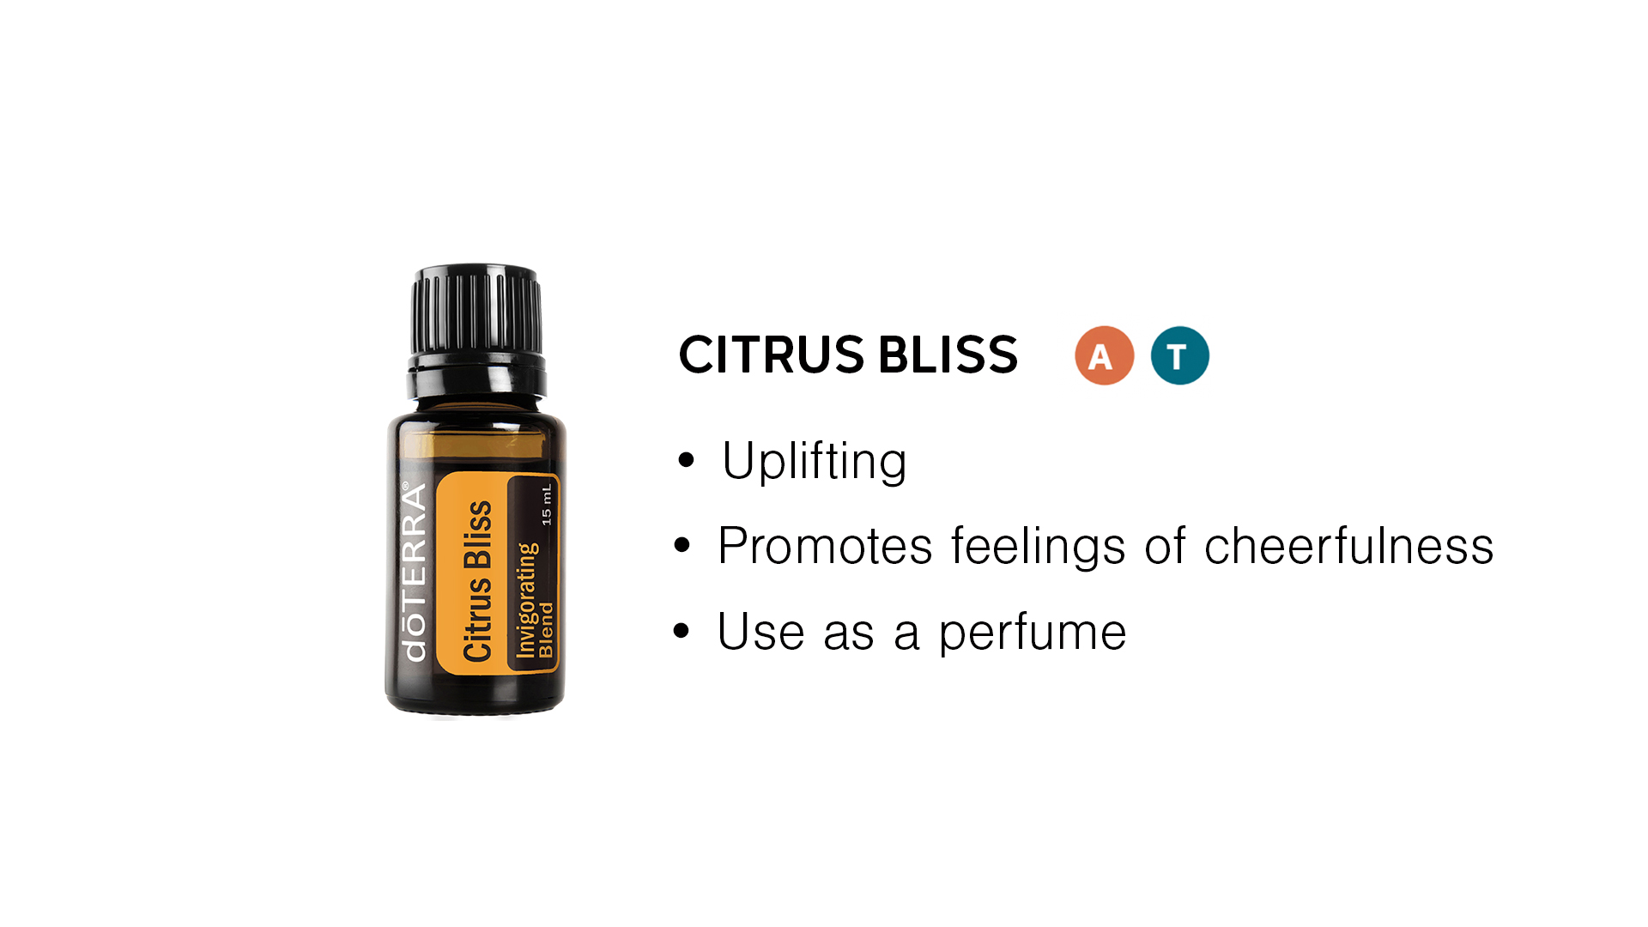

Slide 14



Slide 15



Slide 16

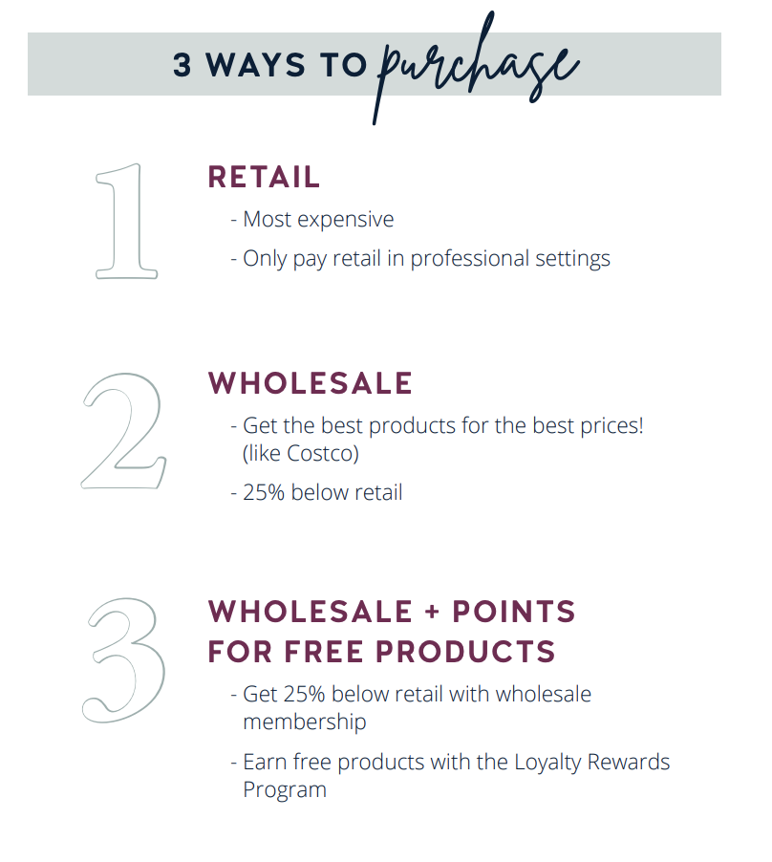

Slide 18


Slide 19

$160 / 100 PV

Slide 20

$350 / 250 PV

Slide 21

$570 / 400 PV

Slide 22


Slide 23



Slide 24


Slide 25
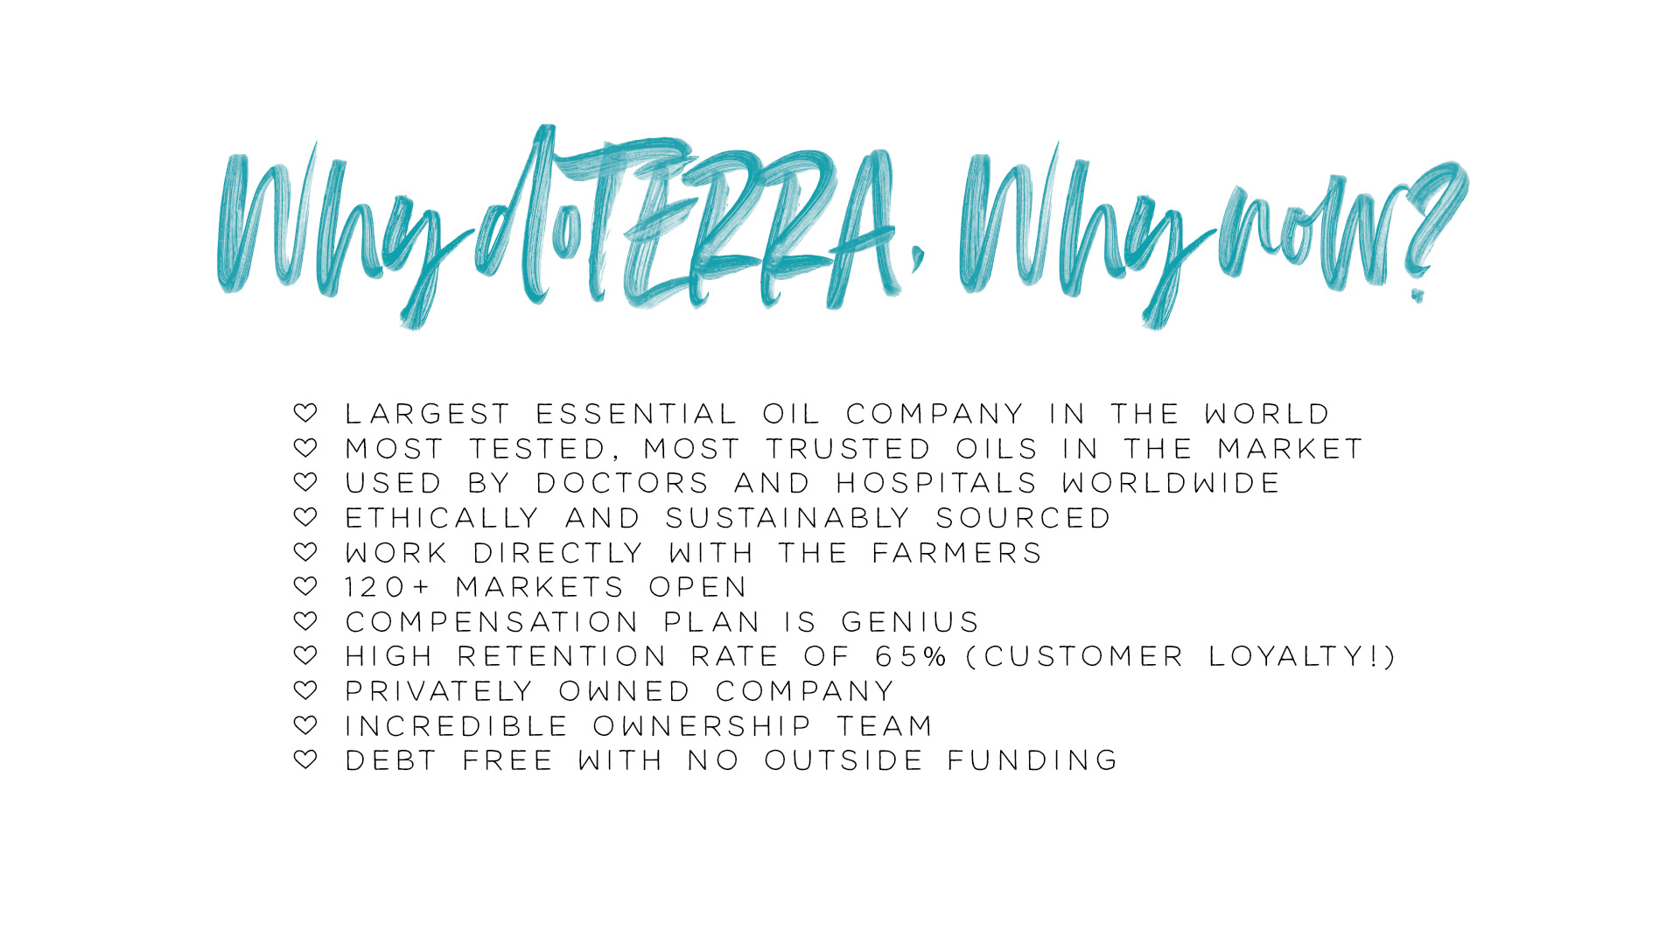

Slide 26


Slide 27


Slide 28


Slide 29
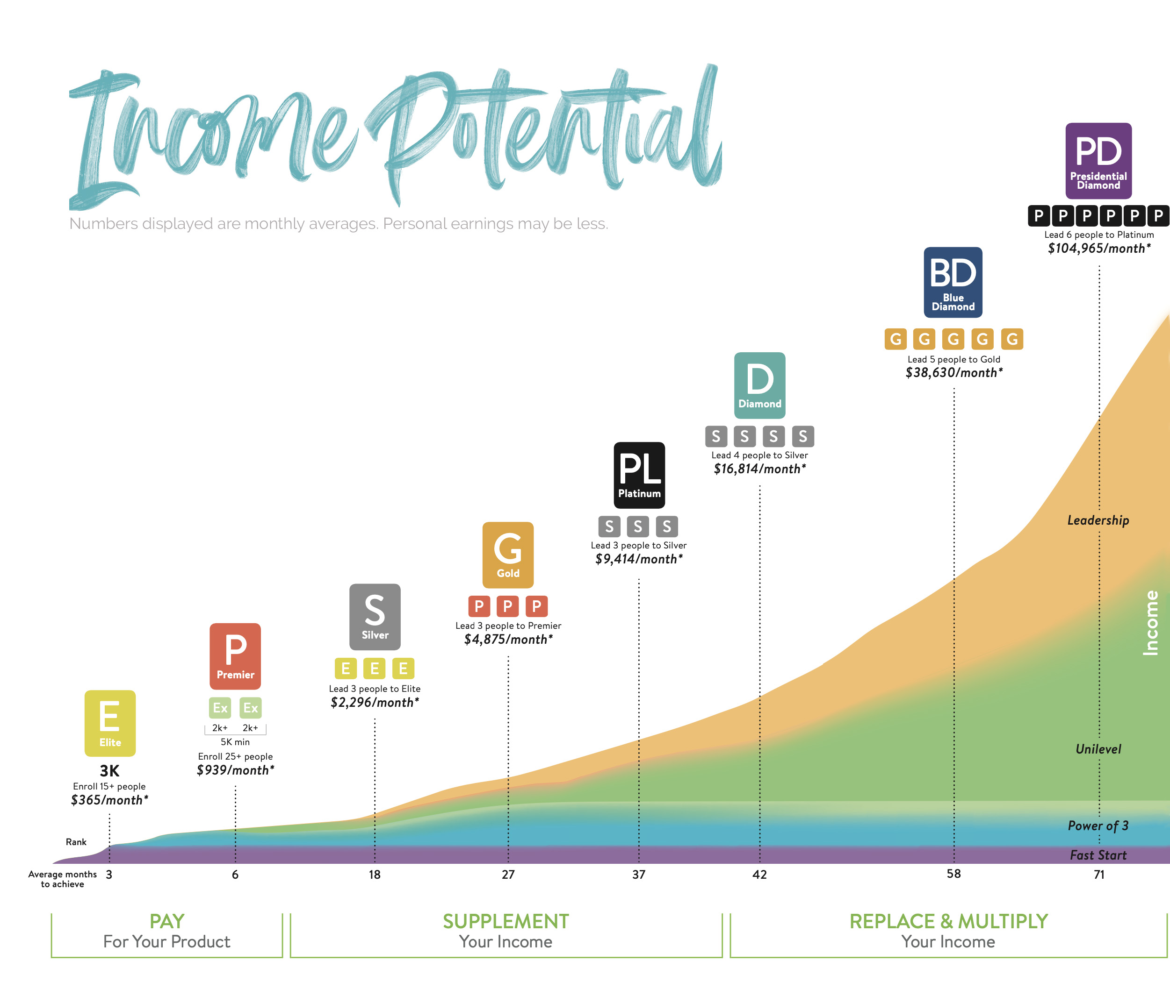

Slide 30
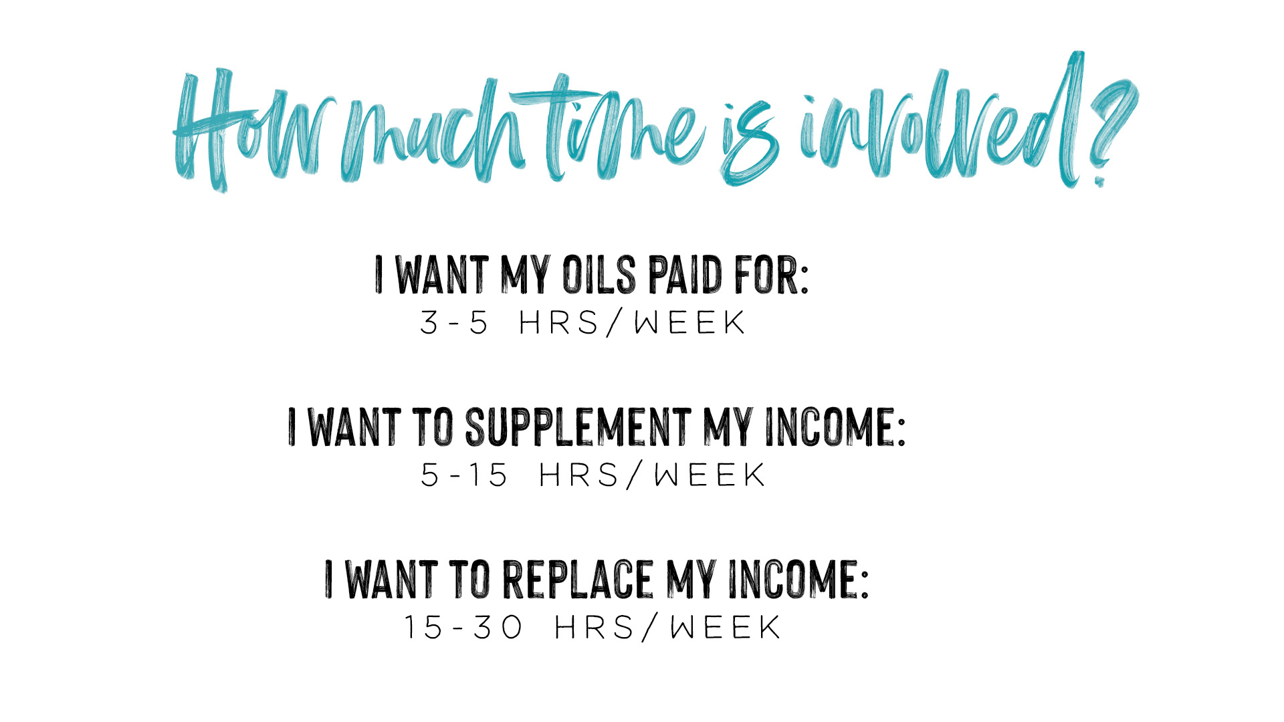

Slide 31


Slide 32
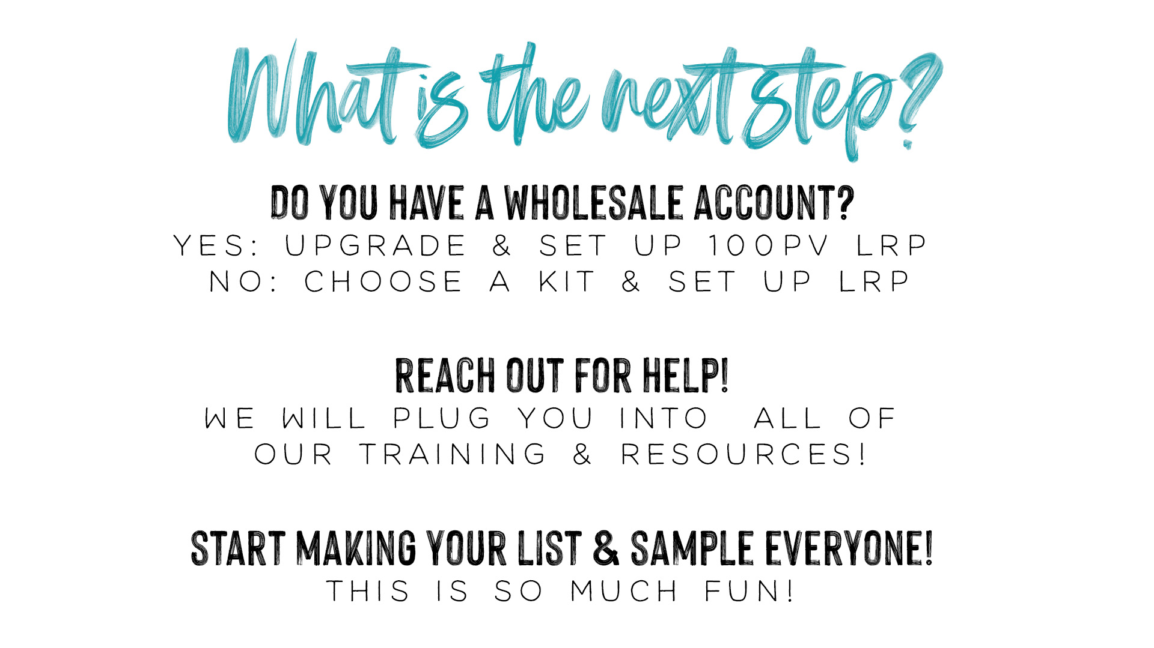

Slide 33


